Slide 1
SOLID WASTE RECYCLING INDUSTRY

Slide 2
GROUP 1
MAJ. BAZLUR RASHID 201714008
MASRUR HASAN MAHIN 201714027
MD. ARIFUL ISLAM TAREK 201714030
MD. RAQIBUR RAHMAN 201714040
MD. ISMILE HOSSIAN 201514027

Slide 3
VISITED ORGANIZATION

Slide 4
DHAKA NORTH CITY CORPORATION
- CDRE. M.A. RAZZAK , HEAD OF WASTE DISPOSAL
THE BENGAL GLASS WORKS LTD.
- ZAKIR HOSSAIN, AGM-SUPPLY CHAIN

Slide 5
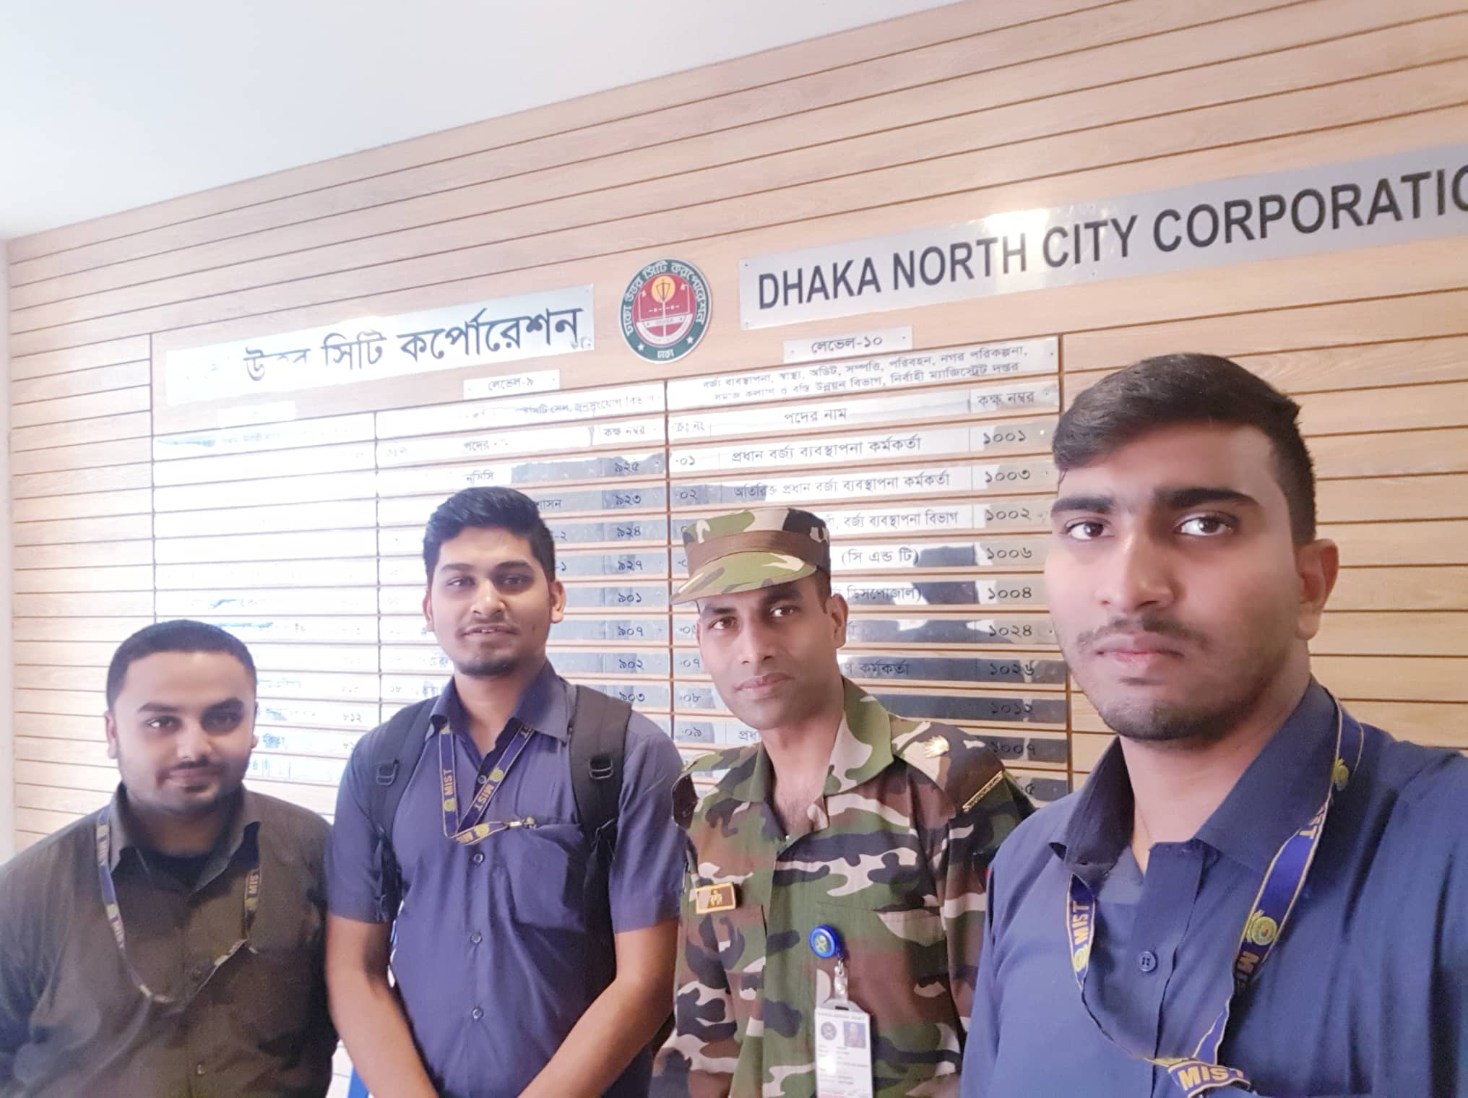
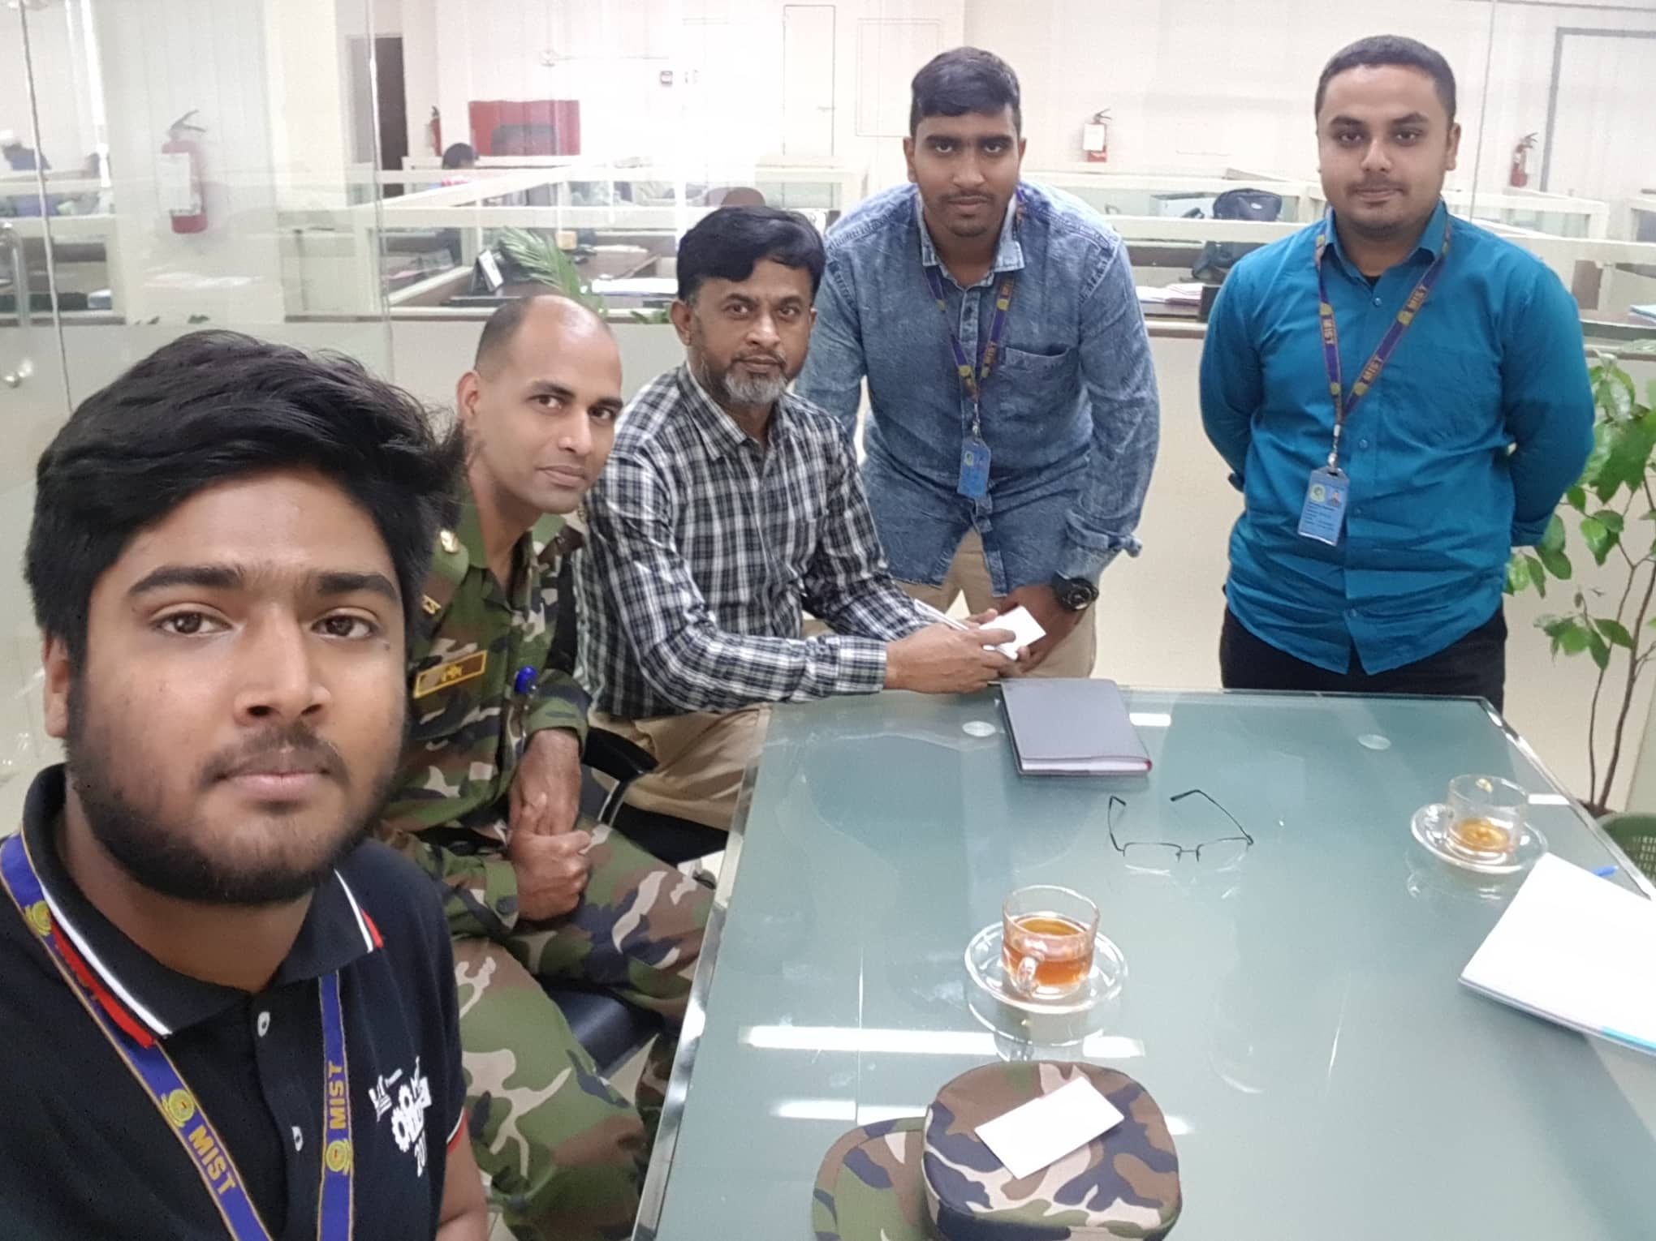

Slide 6
SCOPE
TYPES RECYCLING
DETAILS OF RECYCLING PROCESS
FUNCTIONALITIES OF RECYCLING INDUSTRIES
ORGANIZATION OVERVIEW
- SUPPLIER
- MANUFACTURER
- CONSUMER

Slide 7
TYPES OF ORGANIZATION
- THE BENGAL GLASS WORKS LTD.
- GEMS GLASS FACTORY
- RENATA
- OTOBA TYRE INDUSTRIES
- PYROLYSIS FUEL INDUSTRIES

Slide 8
TYPES OF RECYCLING
- FOOD & VEGETABLE
- CLOTHES - METAL
- WOOD
- METAL
- GLASS
- PLASTIC
- PAPER

Slide 9
RECYCLING PROCESS
Various Recycling process according to the waste types
Connection to and from the process with the organization
Recycling process handled down to collection up to consumer
Turn overs are calculated and manged

Slide 10
ORGANIZATION OVERVIEW
SUPPLIER
- COLLECTION
- AGENTS
- TRANSPORT

Slide 11
ORGANIZATION OVERVIEW
MANUFACTURER
- SUPPLIER
- EMPLOYEES
- PRODUCTION
- TURN OVER
- CONSUMERS

Slide 12
ORGANIZATION OVERVIEW
CONSUMER
1. INDIRECT
- DAILY LIFE USERS
2. DIRECT
- COMPANIES
- LOCAL DEALERS

Slide 13

FRONT END
JAVA

Slide 14
THANK YOU

